Slide 1


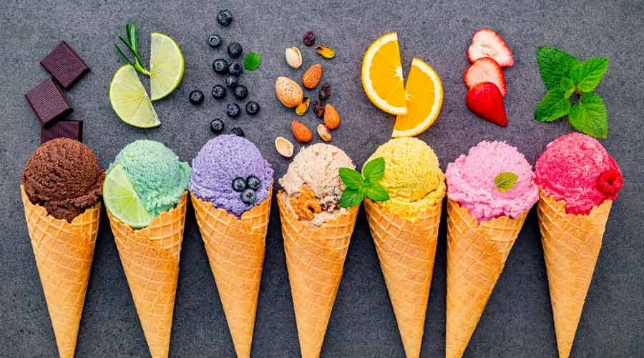
Tasty Foods Inc Case study solution
Rahul Kumar

Slide 2
From the given scenario and the above assumptions, I have deduced the following generic problems one might face, from a customer’s perspective, in a typical food court.
Due to the small size of the food court, it will be very easy to explore the entire area and the food vendors.
Finding a clean and sanitized table won’t be an easy task.
After placing an order, there is no system that lets the customer know about the status of the order.
The customer is always looking at the counter to check his/her token number, which thereby reduces the customer experience.
It is very difficult for a customer to order more food while he/she is already eating because if they have to, they would again need to wait in a long queue.

Slide 3
Automate and streamline Order intake and delivery Enhance customer experience
Step-1: Enter Hi-tech mall
Step-2: Log-in to the Tasty Foods Inc app
Step-3: Check seat availability
Step-4: View a list of restaurants
Step-5: Choose a restaurant
Step-6: Select Dish
Step-7: Pay for your order
Step-8: Receive Order Acceptance
Step-9 :Receive Order Completion
Step-10: View Navigation towards the restaurant
Step-11: Receive Order.

Slide 4
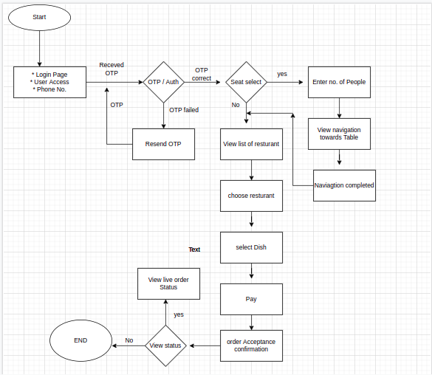

Slide 5
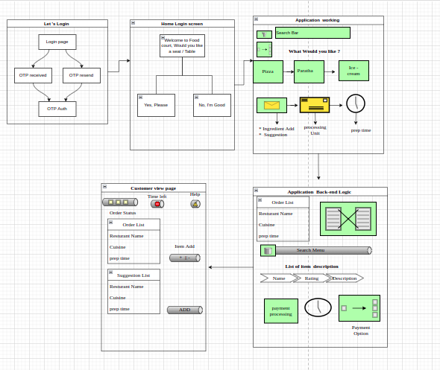

Slide 6
Thanks

